Slide 1



DepClean: Automatically revealing bloated software dependencies in Maven projects

Slide 2

What Ma en does for us?
Build Maven projects (compile, test, deploy)
Resolve dependencies automatically
Execute tests, add documentation, resources, etc. in a configurable manner
Release our software artifact to Maven Central
Guarantee reproducible builds (pom.xml file)
Analyze the dependencies in our projects
Consistent project structure (better collaboration)
Allow us adding customized plugins

Slide 3
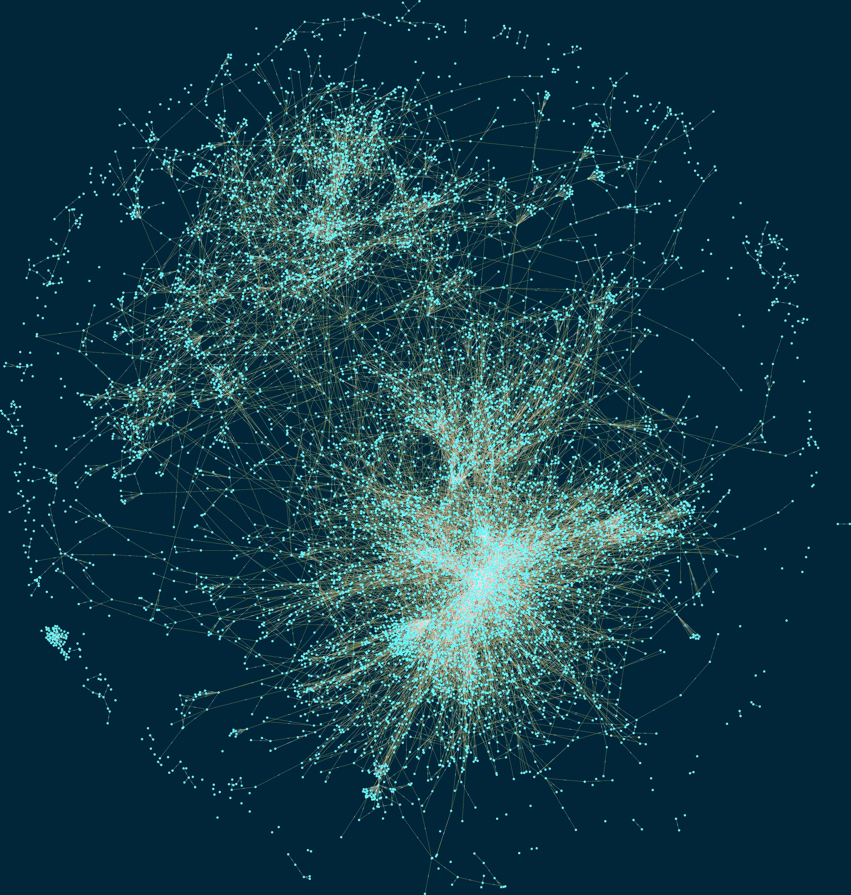
The Maven Ecosystem is big
3.6M nodes in 2019
The Maven Dependency Graph: a Temporal Graph-based Representation of Maven Central (MSR’19)

Slide 4
Example
P
A
B
C
Direct dependencies
D
E
F
Transitive dependencies

Slide 5
Example
P
A
B
C
D
E
F

Slide 6
Example
P
A
B
C
D
E
F

Slide 7
Example
P
A
D
F

Slide 8
Example
P
P
A
B
C
A
F
D
E
F
D
We should reduce the size of the dependency tree by removing unused dependencies.

Slide 9
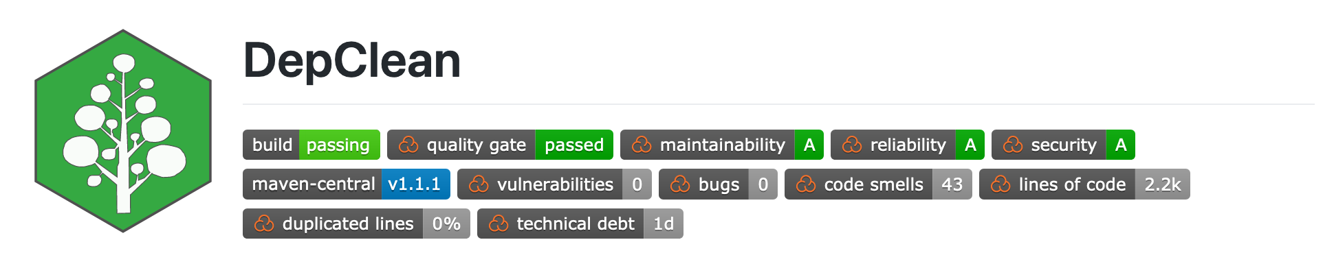
DepClean
Detect bloated dependencies
Automatic generation of a debloated pom.xml file
Open source
https://github.com/castor-software/depclean

Slide 10
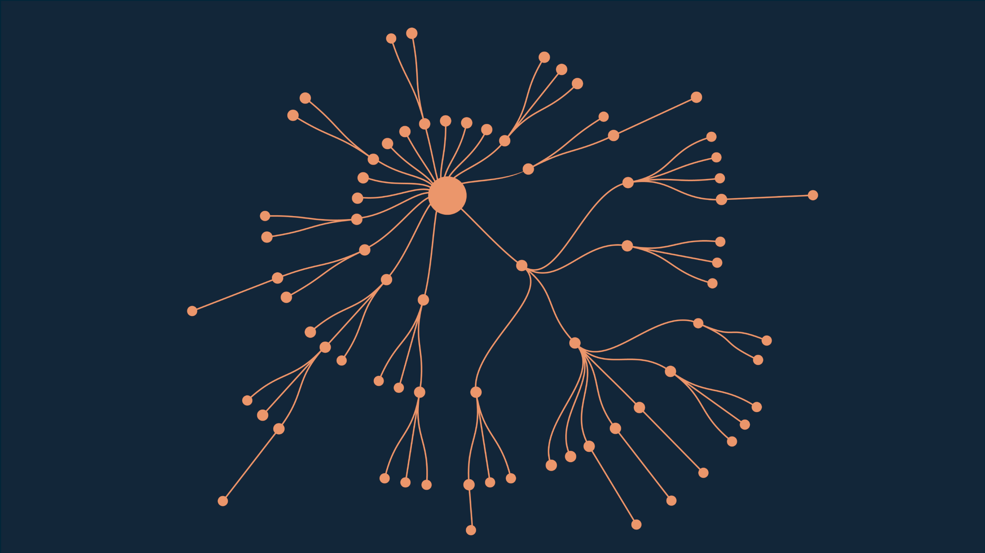
Spoon
Open source library for code analysis, 75 dependencies

Slide 11
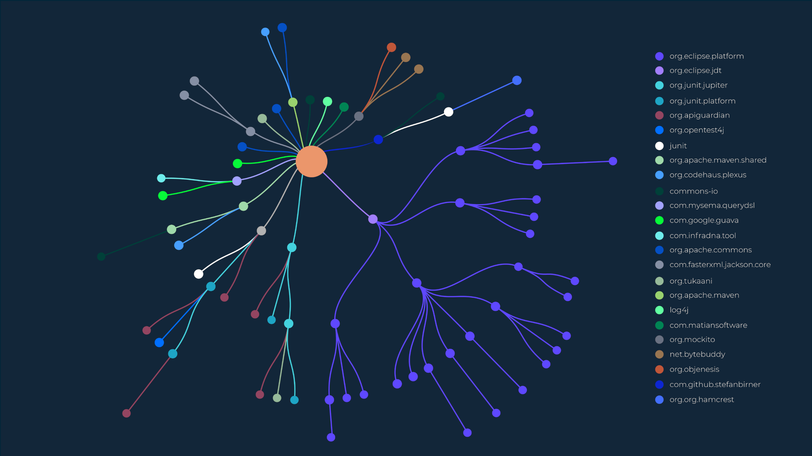
Spoon
24 different dependency providers

Slide 12
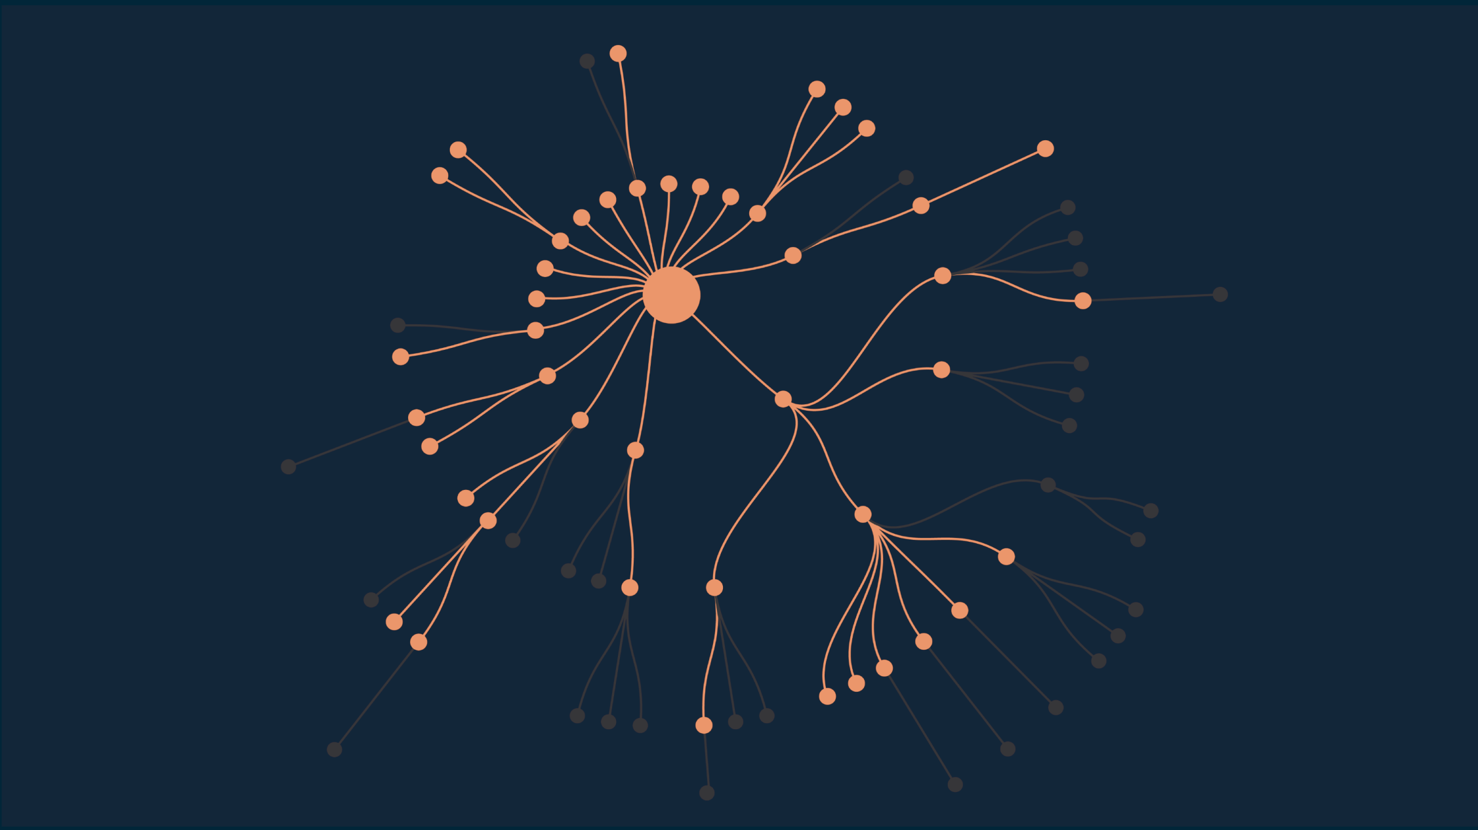
Spoon
Maven excludes 31 redundant dependencies

Slide 13
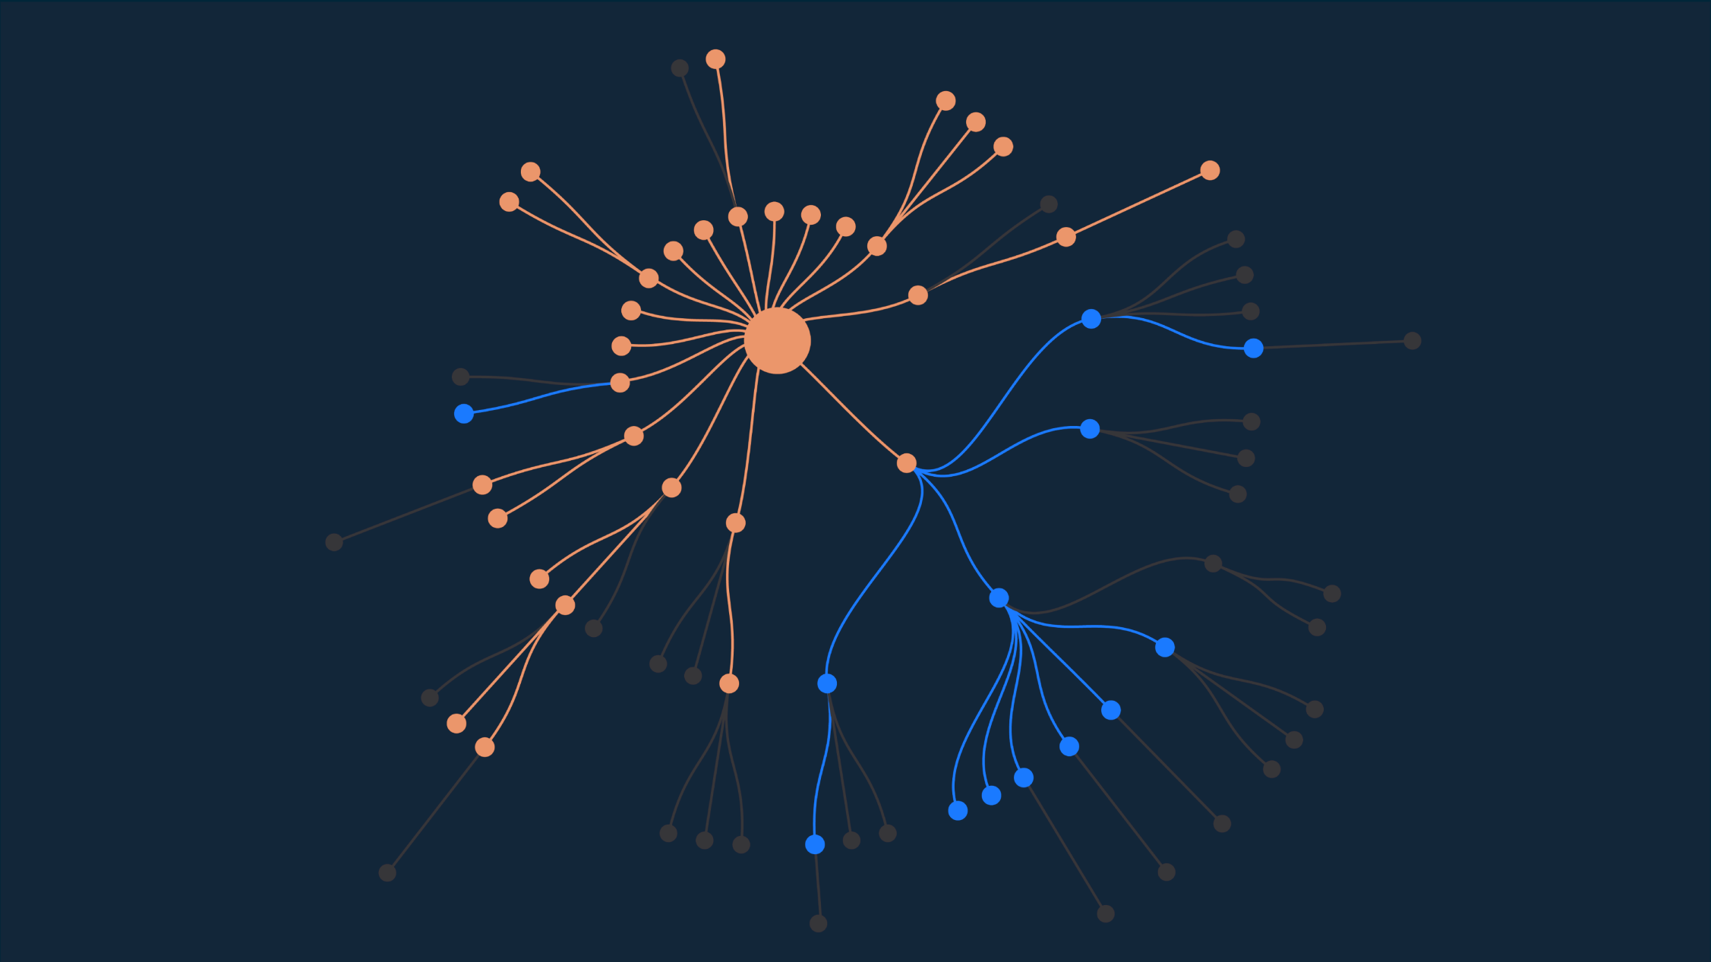
Spoon
DepClean detects 13 bloated dependencies

Slide 14
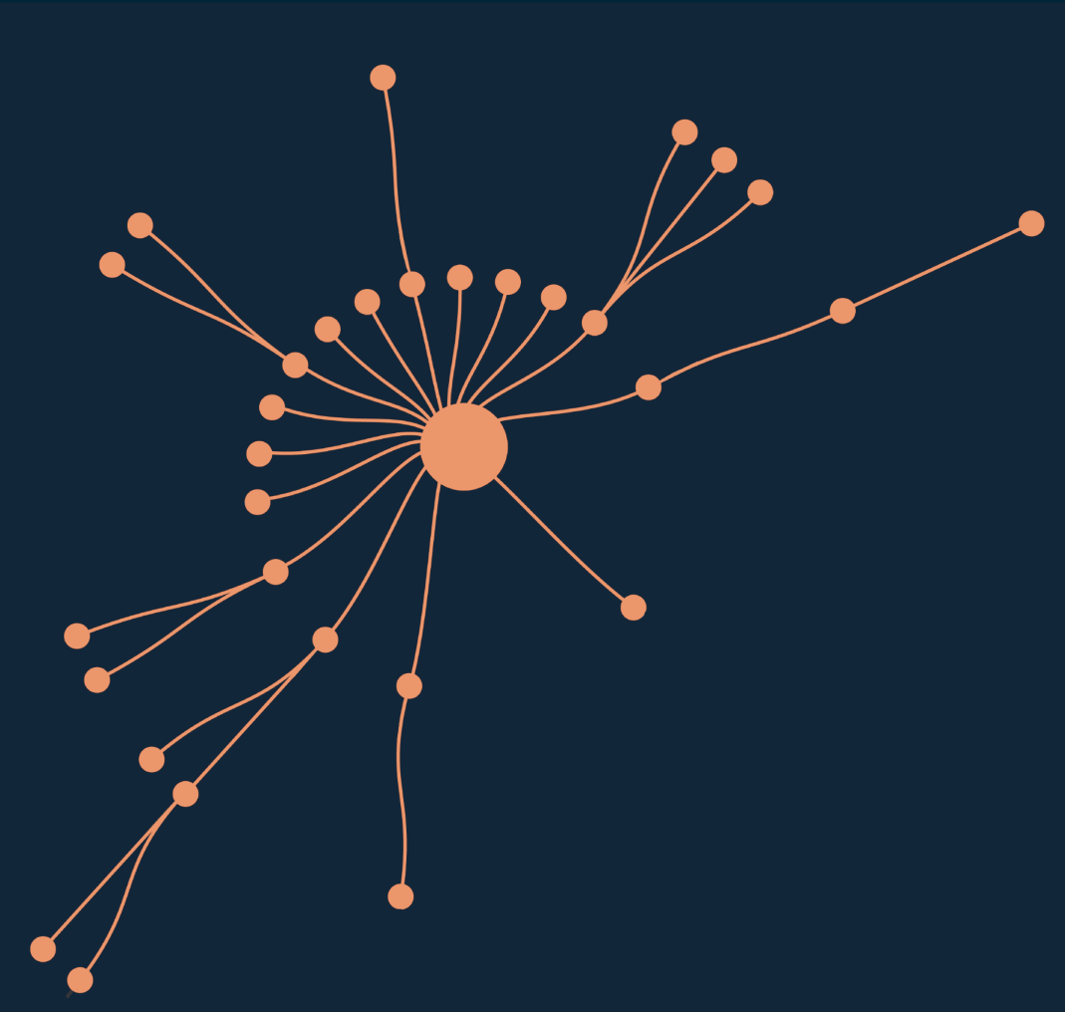
Spoon
 | JAR Size (MB) | #Classes
Before | 16.2 | 7 425
After | 12.7 | 5 593
Reduction (%) | 27.6% | 24.7%

Slide 15
Empirical study
9K artifacts and 700K dependencies
2.7% of direct dependencies are bloated
15.1% of inherited dependencies are bloated
57% of transitive dependencies are bloated

Slide 16
Results
9K artefacts and 700K dependencies
75% of dependencies are bloated
DepClean Maven dependency debloating tool
To appear in EMSE journal, 2020
Developers care
Removed 131 dependencies in 30 projects
Experiments at SAP and Ericsson ongoing

Slide 17
Results
9K artefacts and 700K dependencies
75% of dependencies are bloated
DepClean Maven dependency debloating tool
To appear in EMSE journal, 2020
Developers care
Removed 131 dependencies in 30 projects
Experiments at SAP and Ericsson ongoing

Slide 18
Conclusion
There is lot of code bloat
From libc to Chrome
caused by reuse, feature creep, usage, etc.
Software developers care
For security
For performance
It is a relevant research topic
That is hard
That matters

